Slide 1
Battle of Neighbourhoods
Toronto

Slide 2
Introduction
Toronto is a popular destination for new immigrants in Canada to reside.
Aim of this project is to help people in exploring better facilities around their neighbourhood.
Help people to get awareness of the area and neighbourhood before moving to a new city, state, country or place for their work or to start a new fresh life.

Slide 3
Business Problem
Which neighbourhoods are the best to live in the terms of convenience?
Which neighbourhoods lack the infrastructure facilities?
Which neighbourhoods have the potential for the development of infrastructure of different kinds?

Slide 4
Data
Data Link: https://en.wikipedia.org/wiki/List_of_postal_codes_of_Canada:_M
The data will be scraped from the link above. The dataset consists of latitude and longitude, zip codes.
Foursquare API
Foursquare is a location data provider with information about all manner of venues and events within an area of interest.
Such information includes venue names, locations, menus and even photos.

Slide 5
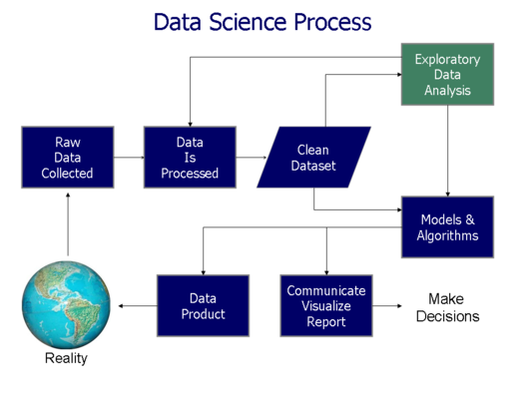
Methodology
Image extracted from www.kdnuggets.com

Slide 6
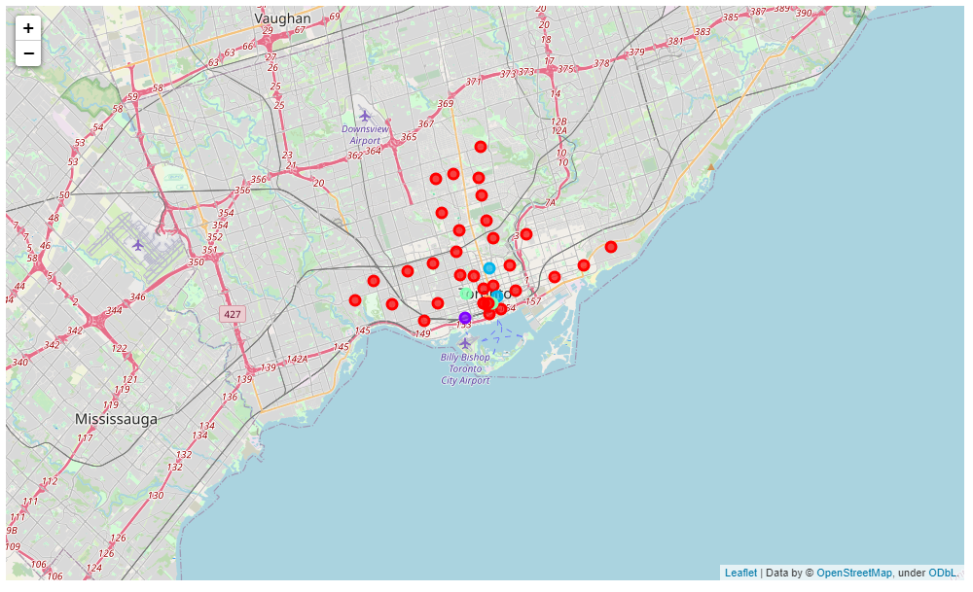
Results

Slide 7
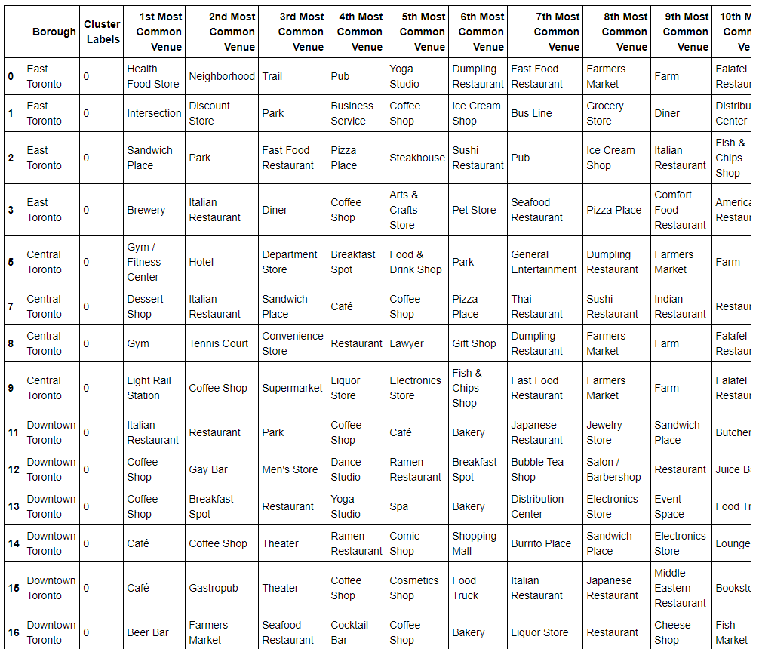
Cluster 1

Slide 8
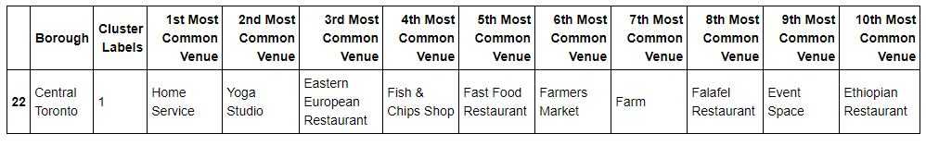
Cluster 2

Slide 9
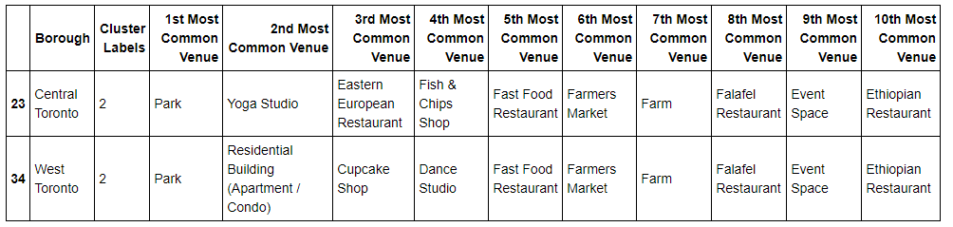
Cluster 3

Slide 10
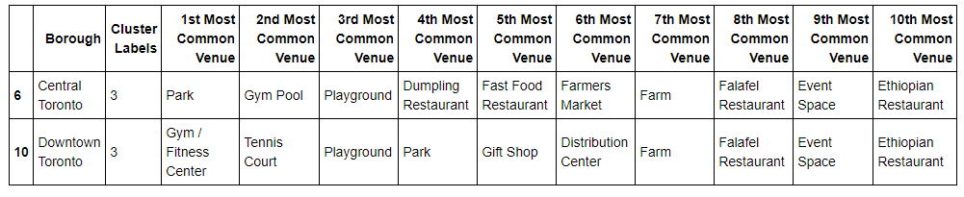
Cluster 4

Slide 11
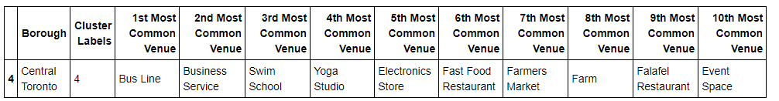
Cluster 5

Slide 12
Discussion
Based on the results shown above, each of the clusters are segmented based on the similarity of ‘most common venue’.
The major purpose of this project is to suggest a better neighborhood in a new city for the person who are shifting there. Connectivity to the airport, bus stand, city center, markets and other daily needs things nearby.

